Slide 1















PC Controller with Hand Gestures
Tanisha Bansal 9921103037
Nikhil Raj 9921103106
Shubham Mittal 9921103115

Slide 2
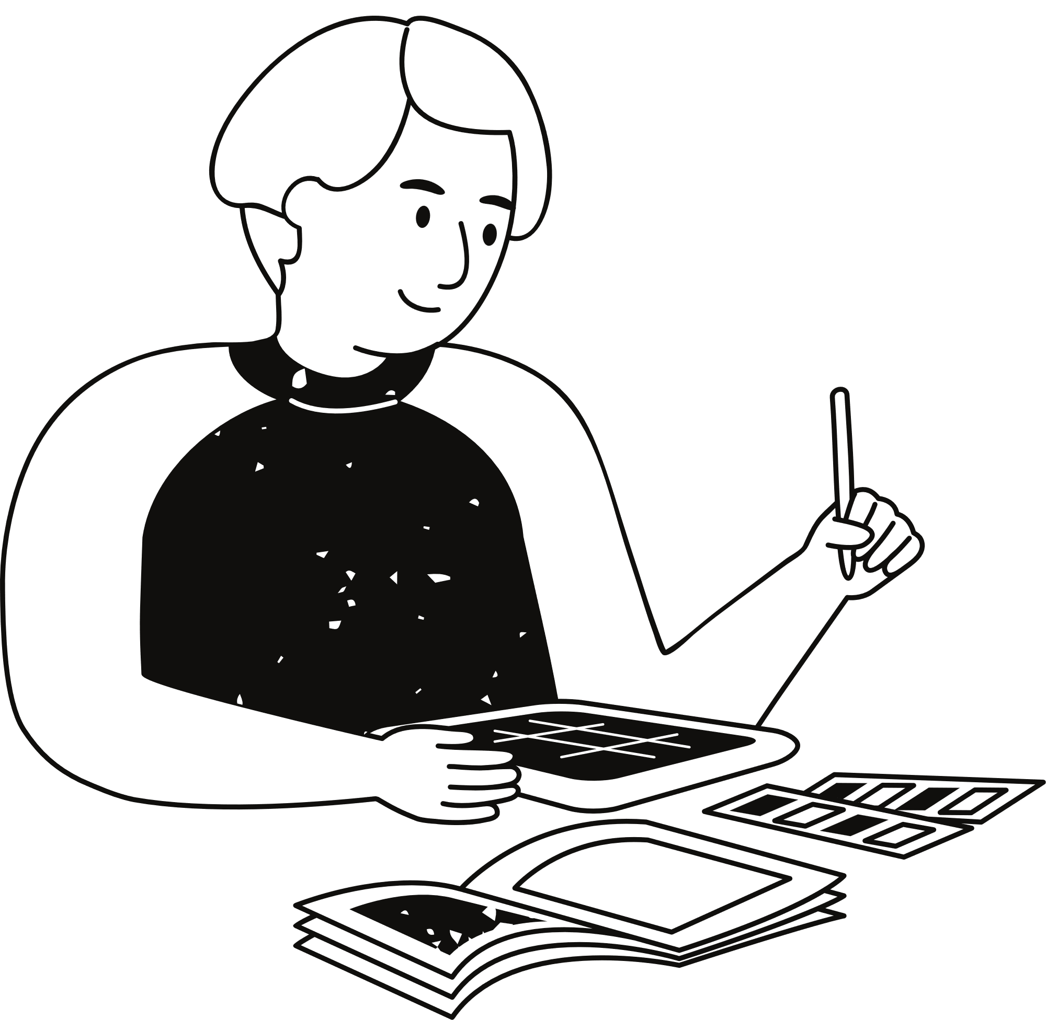
Introduction
The Virtual Mouse project aims to replace traditional mouse interactions with hand gestures, providing a touchless interface. By utilizing computer vision techniques and machine learning, specifically hand tracking through Mediapipe, this system allows users to control the cursor and perform mouse functions such as clicks, double-clicks, and drag without physically touching the mouse. The project is highly relevant in modern times where touchless technologies are gaining importance in various applications, especially in pandemic scenarios, healthcare, and accessibility solutions.

Slide 3
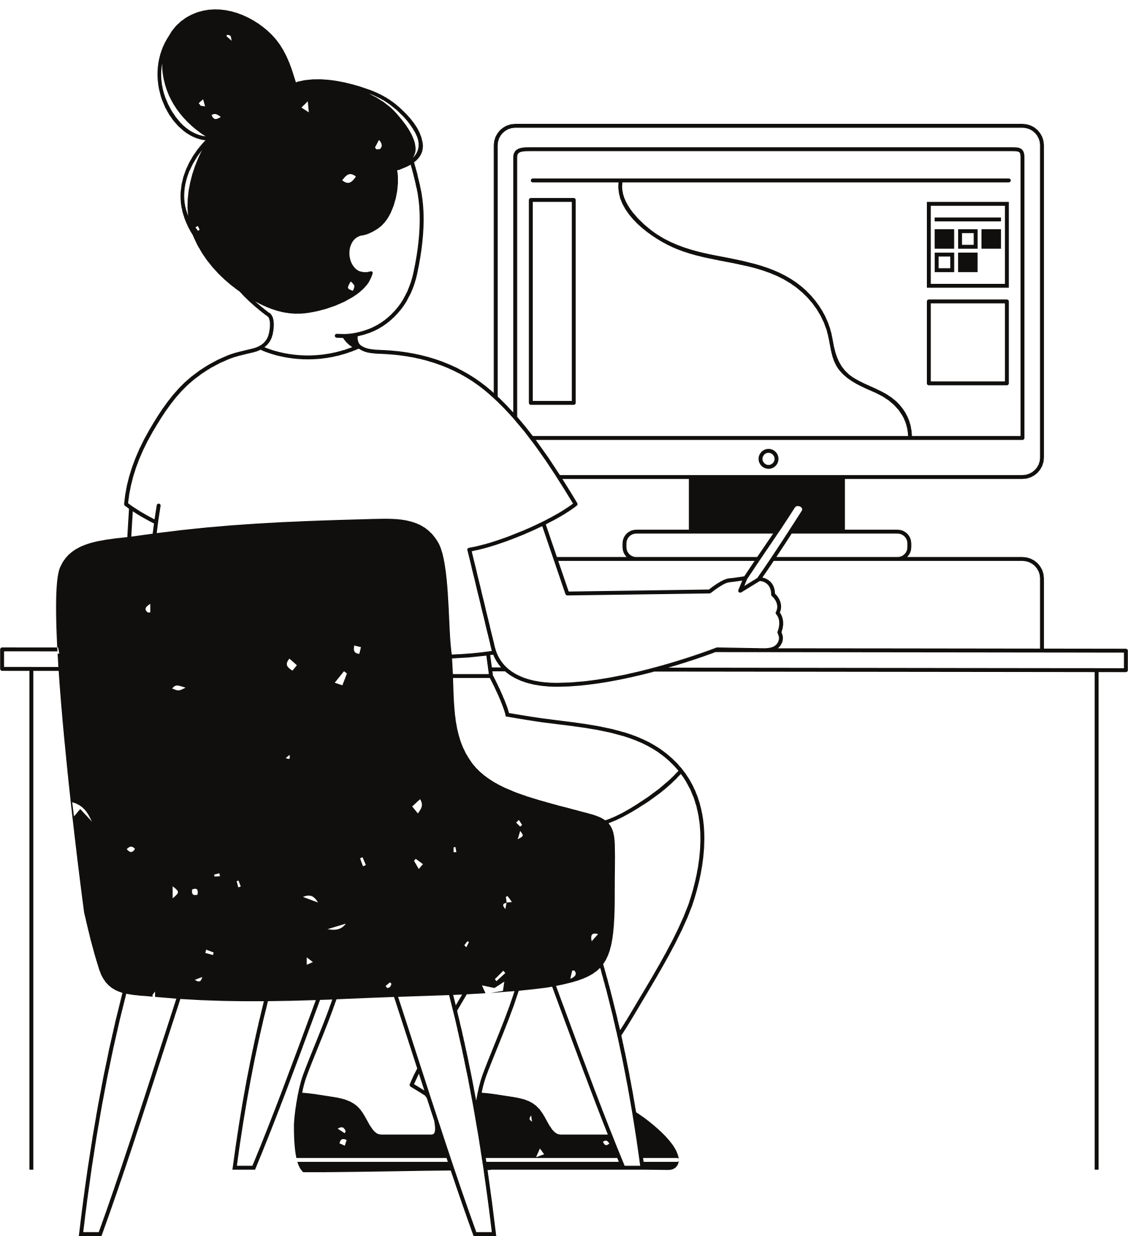
Objective
The primary objective of this project is to develop a virtual mouse system that detects hand gestures in real time and translates them into mouse events. The specific goals include:
Implement permission to open webcam.
Implement single hand detection.
Implement hand tracking and gesture recognition using Mediapipe.
Enable mouse movement through index finger gestures.
Facilitate single and double-click actions using thumb and finger gestures.
Detect gestures for special functions such as closing the application with a "thumbs-up" gesture.

Slide 4
Literature Survey
[1] V. K. Sharma, V. Kumar, S. Tawara, and V. Jayaswal, "Virtual Mouse Control Using Hand Class Gesture," GIS Science Journal, vol. 7, 2020.
[2] R. Sande, N. Marathe, N. Bhegade, A. Lugade, and S. S. Jogdand, "Virtual Mouse using Hand Gestures," International Journal of Advanced Research in Science, Engineering & Technology, vol. 8, no. 4, pp. 2350-0328, Apr. 2021.
[3] G. S. Mahitha, B. Revanth, G. Geetha, and R. Sirisha, "Hand Gesture Recognition to Implement Virtual Mouse Using Open Source Computer Vision Library: Python," in Learning and Analytics in Intelligent Systems, 2021, pp. 435–446, doi: https://doi.org/10.1007/978-981-15-9293-5_39.
[4] "Stack Overflow", https://stackoverflow.com/.

Slide 5
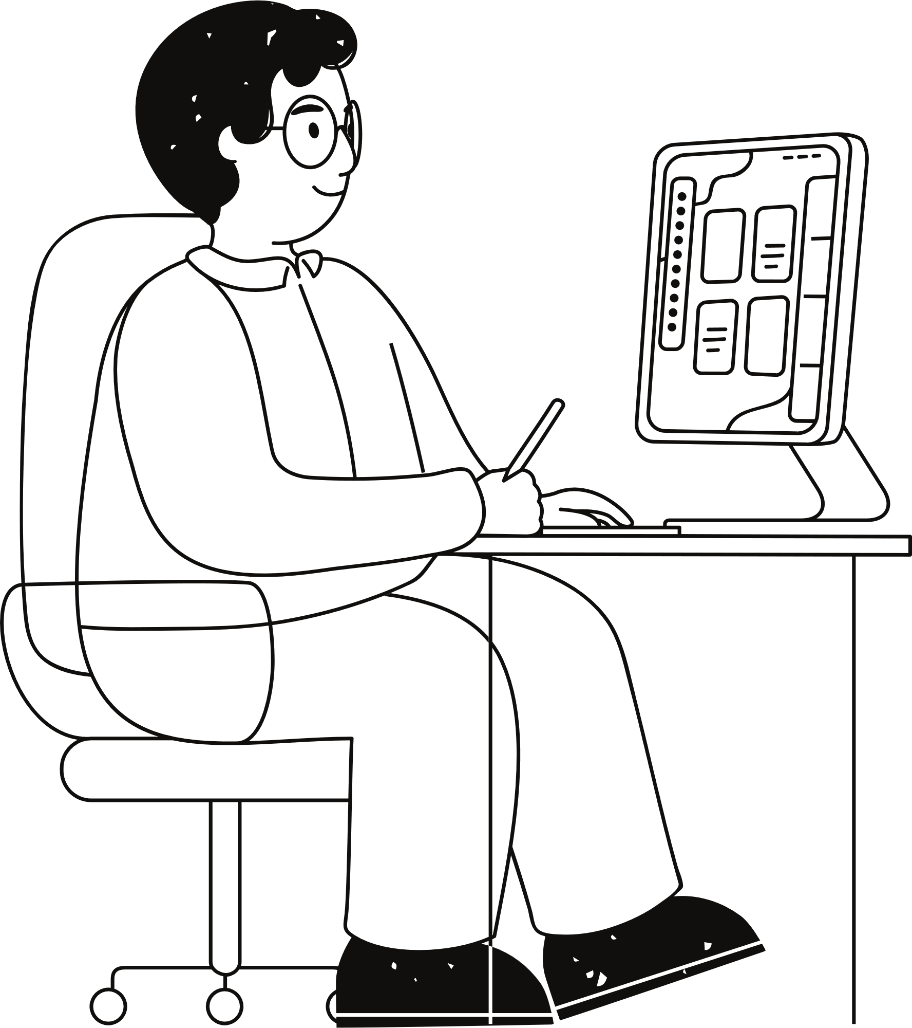
Methodology
1. Webcam Access:
Capture real time video feed using OpenCV.
Flip the captured frame for a more natural, mirrored interaction.
2. Hand Detection and Tracking:
Use Mediapipe’s hand tracking solution to detect and track hand landmarks.
Process the frame in RGB color space and analyze hand gestures based on the positions of fingertips and thumb.

Slide 6
Methodology
3. Gesture Recognition:
● Cursor Movement
Raise both the index and middle fingers while keeping the rest of the fingers and thumb closed.
● LeftClick
Raise both the index and middle fingers, then click using the index finger.
● Right Click
Raise both the index and middle fingers, then click using the middle finger.
● DoubleClick
Double tap the index finger and middle finger together in rapid succession.
● Vertical Scroll
Pinch thumb and index finger and then move the hand up or down.

Slide 7
Methodology
● Horizontal Scroll
Pinch thumb and index finger and then move the hand right or left.
● Multiple Select
Close all fingers into a fist, then move the hand to select multiple items.
● Drag and Drop
Close all fingers into a fist and move the hand to drag the item, releasing the fist to drop it at the desired location.
● Special Gestures
Ask for permission while opening the terminal.

Slide 8
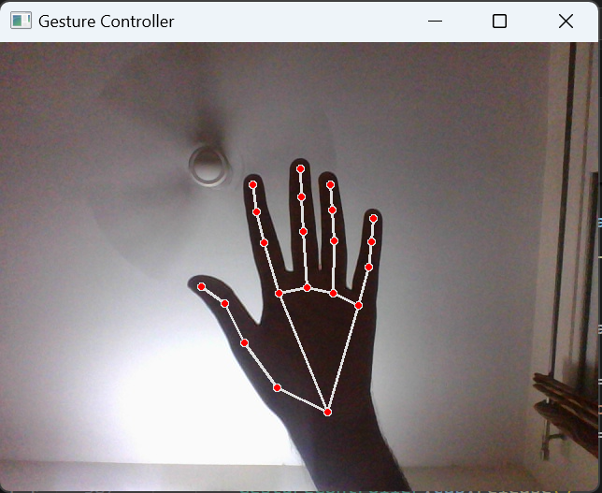
Results & Experiments
Cursor Movement
Gesture: Raise both the index and middle fingers while keeping the rest of the fingers and thumb closed.
Action: Moves the on-screen cursor, with the cursor following the position of the midpoint of the extended index and middle fingertips.

Slide 9
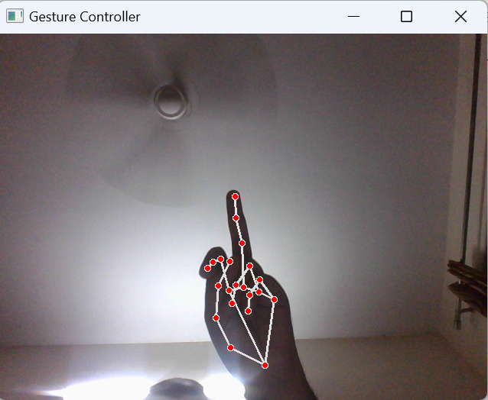
Results & Experiments
Left Click
Gesture: Raise both the index and middle fingers, then click using the index finger.
Action : Simulates a left-click.

Slide 10
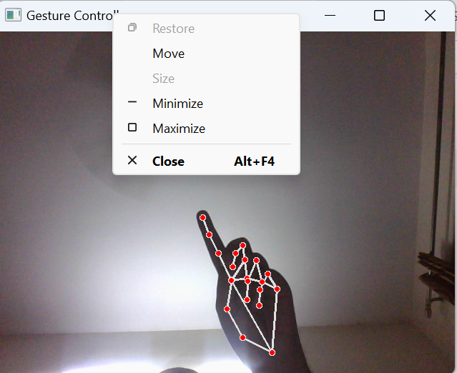
Results & Experiments
Right Click
Gesture: Raise both the index and middle fingers, then click using the middle finger.
Action: Simulates a right-click.

Slide 11
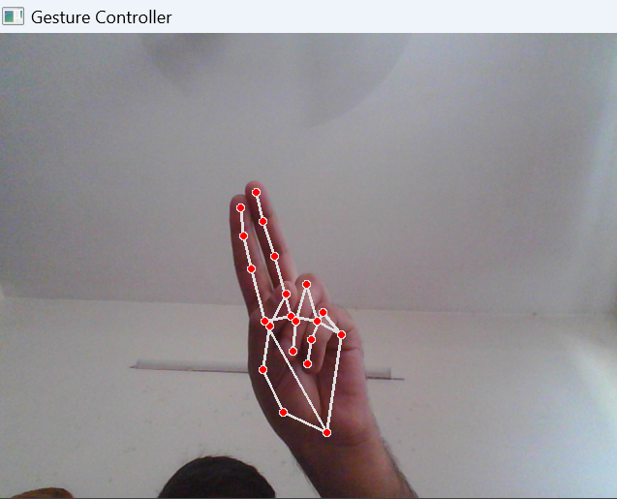
Results & Experiments
DoubleClick
Gesture: Double tap the index finger and middle finger together in rapid succession.
Action: Simulates a double-click, often used for opening files or applications.

Slide 12
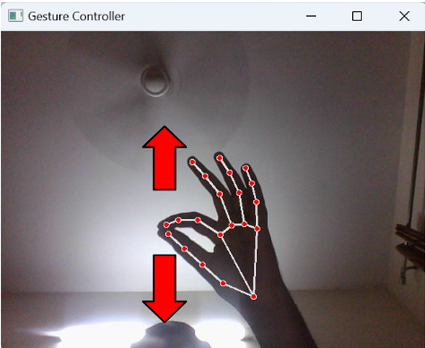
Results & Experiments
Vertical Scroll
Gesture: Pinch thumb and index finger and then move the hand up or down.
Action: Simulates vertical scrolling. The scrolling speed adjusts based on the speed of the hand's movement.

Slide 13
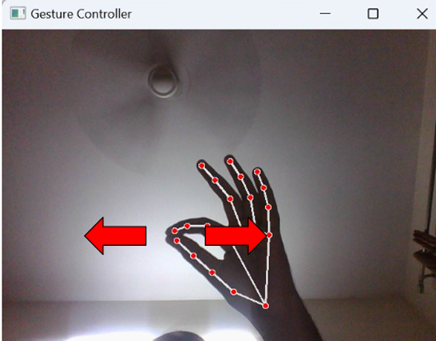
Results & Experiments
Horizontal Scroll
Gesture: Pinch thumb and index finger and then move the hand right or left.
Action: Simulates horizontal scrolling, which can be useful for navigating wide documents or web pages.

Slide 14
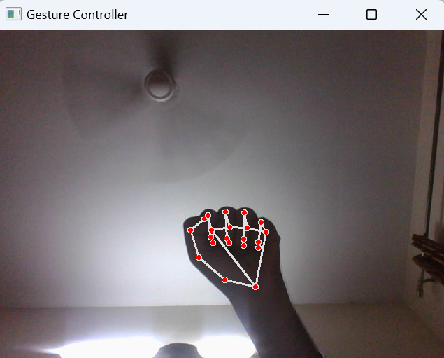
Results & Experiments
Multiple Select
Gesture: Close all fingers into a fist, then move the hand to select multiple items.
Action: Enables multiple selections. Useful for selecting multiple items or lines of text.

Slide 15
Results & Experiments
DragandDrop
Gesture: Close all fingers into a fist and move the hand to drag the item, releasing the fist to drop it at the desired location.
Action: Simulates dragging an item across the screen and dropping it when the gesture is released.

Slide 16
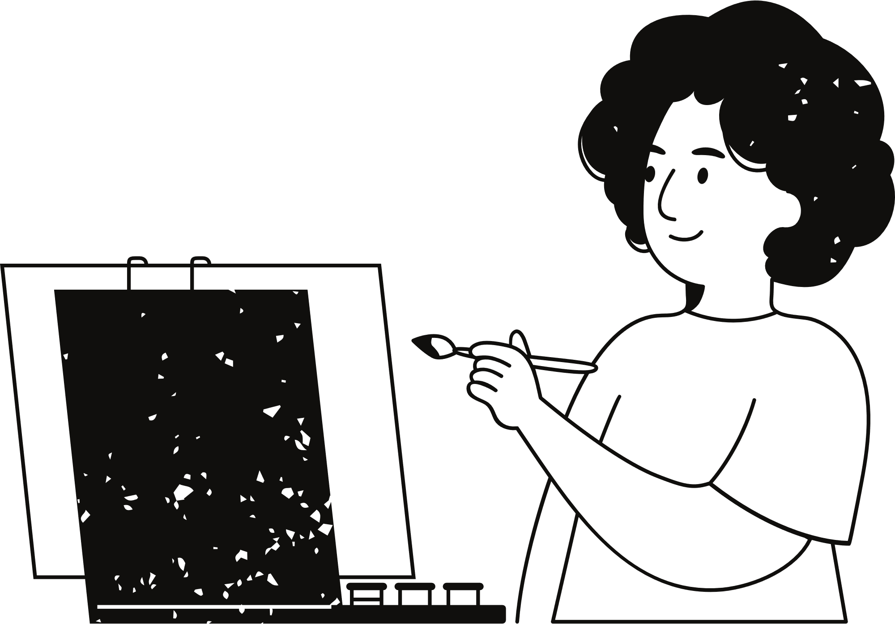
Conclusion and Future work
The virtual mouse system has demonstrated its effectiveness in translating hand gestures into mouse actions with real-time precision, enabling intuitive and contactless control. The successful implementation of features such as Left Click, Right Click, Double-click ,Scrolling ,Drag and Drop, Multiple Item Selection highlights its potential to redefine user interaction. Future enhancements could focus on expanding the gesture library to include multi-finger and dual-hand gestures, integrating speech recognition for improved accessibility, and developing support for commercial applications like gaming and interactive presentations. Additional improvements, such as optimizing gesture recognition for diverse environments and incorporating voice feedback, would further increase the system's versatility and usability. These advancements pave the way for more innovative, accessible, and interactive interface solutions.

Slide 17


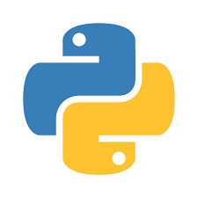
Tech Stack
OpenCV
Mediapipe
Python
PyAutoGUI

Slide 18
Thank you

